Slide 1
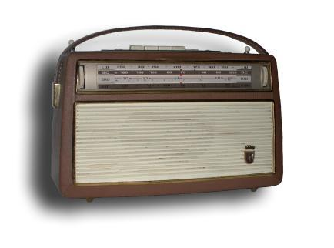

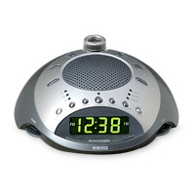
Using Resemblance to Support Component Reuse and Evolution
Andrew McVeigh, Jeff Kramer and Jeff Magee
Department of Computing
Imperial College, London
SAVCBS 2006

Slide 2
Introduction

Slide 3
The Vision of Software Components
Composite components are constructed by composing existing components and connecting them together
E.g. A radio...
This is a scalable concept...
  Entire systems can be represented
  hierarchically in this way
Radio Component
Tuner
Component
Amplifier
Component
system as
a component
Low-level
components

Slide 4
But, Higher Abstraction = Less Reuse
System construction should ideally be a case of connecting together increasingly higher-level components...
BUT the higher the level of abstraction of a component
  the more specific it generally is (buried abstractions)
  the less reusable it becomes...
Invoice system component
for doctor's surgery
I
Cannot reuse for
car dealer invoice system
despite major similarities!
Component to deal
with doctor's fees
F

Slide 5
4 Requirements for a Reuse Solution
Reuse implies (extensive) alterations 1. Alter
Can we just change existing component?
  No! We can't break if it for existing users 2. NoImpact
Can we copy and modify the source?
  No! Must be able to accept upgrades 3. Upgrades
  Copying leads to maintenance problems
  We may not have the full source code 4. NoSource
Conflicting forces
Keep components the same for existing users
Change components for reuse

Slide 6
To address these we introduce two constructs:
Resemblance and Redefinition

Slide 7
Resemblance: Enabling Reuse
Defines a component in terms of similarity to another
  An inheritance-like construct for components
  The new component is specified as add / delete / replace changes to the architecture of a base component
We keep the changes as elements in the new component
  Lets us reason about combining changes, upgrades etc.
Intuitively: ClockRadio resembles Radio, but adds a Clock
Radio
resembles
ClockRadio
Tuner
Tuner
Amp
Amp
1. Add
Clock
2. Add connectors

Slide 8
Redefinition: Modelling Evolution
Used to model evolution of a component
Replaces the existing definition of a component
  The existing definition and the redefinition are kept separate
  Changes will only be applied if redefinition is “loaded”
  Can be combined with resemblance to evolve a component in terms of changes to the old definition
Intuitively: Evolving a Radio to add a Clock
Redefines and
resembles
Radio
Radio'
Tuner
Tuner
Amp
Amp
1. Add
Clock
2. Add connectors

Slide 9
Using the Constructs
These can be used independently, or together:
Resemblance
  defines one component in terms of changes to another
Redefinition
  changes the definition of an existing component
Resemblance + redefinition
  allows evolution of an existing component in terms of changes to the previous definition

Slide 10
The Notation

Slide 11
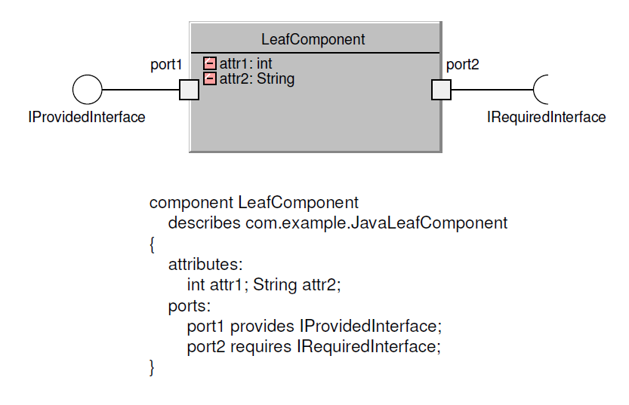
Notation for Leaf Components
The graphical form is UML2 composite structure diagrams.
The textual form is remarkably similar to Darwin.

Slide 12
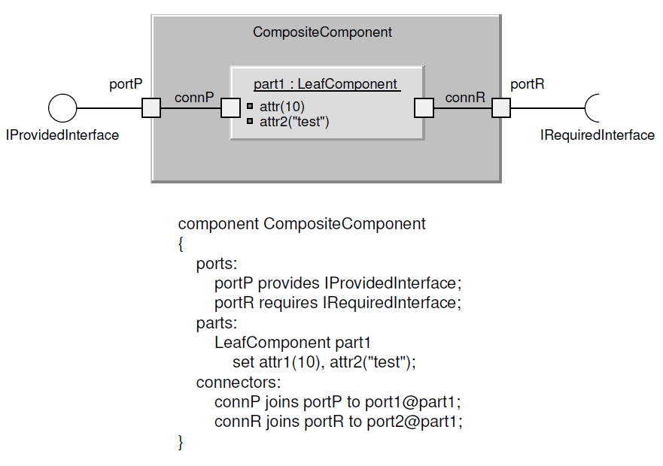
Notation for Composite Components

Slide 13
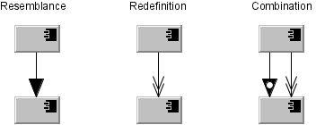
Notation for the Constructs
Applies to both composite and leaf components

Slide 14
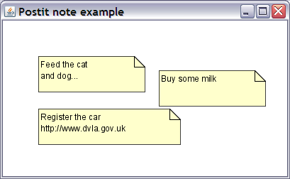
Example
A note taking application

Slide 15
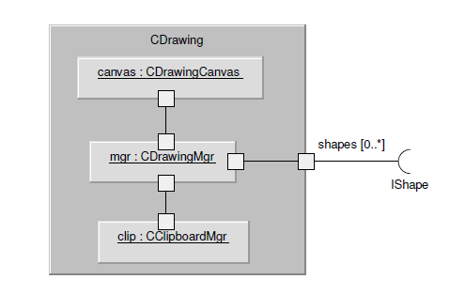
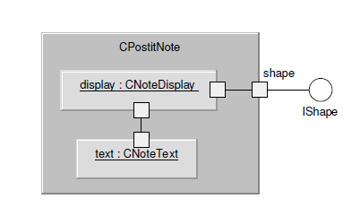
The Base Application
Company X makes a drawing application, which has a postit-note component

Slide 16
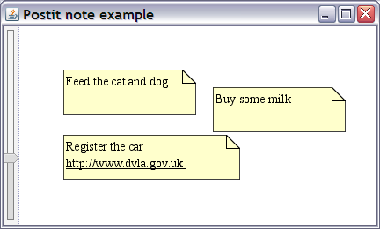
Reusing and Altering
Company Y wishes to reuse and customise
  Add a zoom facility
  Remove the clipboard
  Add hyperlinked text

Slide 17
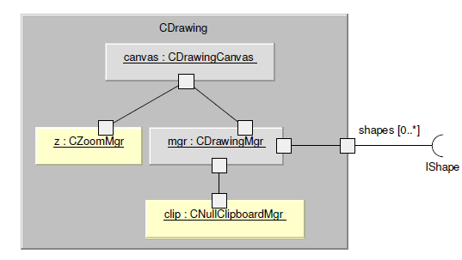
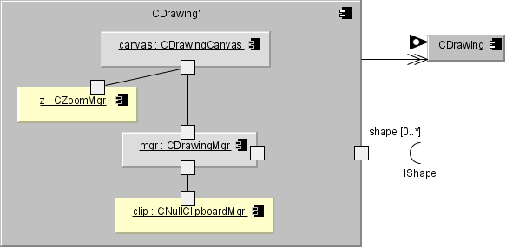
Using Resemblance to Alter (1)
redefine-component CDrawing
resembles [previous] CDrawing
{
replace-parts:
CNullClipboardMgr clip;
parts:
CZoomMgr z;
connectors:
zoom joins zoom@z to surface@canvas; }

Slide 18
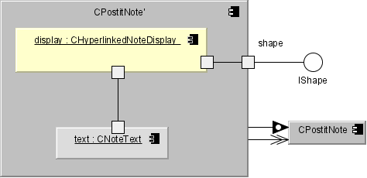
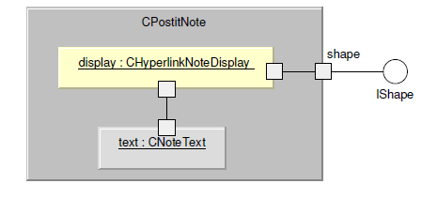
Using Resemblance to Alter (2)
redefine-component CPostitNote
resembles [previous] CPostitNote
{
replace-parts:
CHyperlinkNoteDisplay display;
}

Slide 19
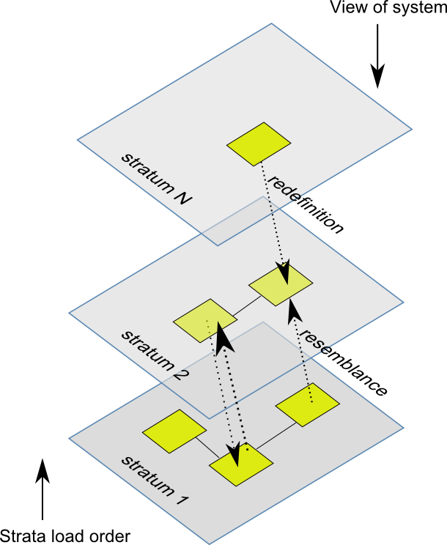
Conceptual Overview
A stratum groups a set of related definitions
Resemblance copies an existing component's definition into the current definition, and allows changes
Redefinition pushes a new definition back into an existing name

Slide 20
Issues
Most issues occur when combining multiple redefinitions of the same component
  This occurs when combining independently developed changes. This related to a merge conflict in a CM system.
How do we reason about the soundness of combined redefinitions?
  What is the resultant system behaviour?
  Does the combination accomplish the goals of each redefinition, or do they conflict?
Currently only for non-distributed architectures...

Slide 21
Related Work

Slide 22
Related Work
MAE
  Architectural configuration management system
Various programming language constructs
  Mixins, nested inheritance
ADLS
  Darwin, ROOM, C2SADEL etc.
Koala & product line architectural approachs
  Parametrization for reuse
  Variation points
COM and other component standards
  mechanisms versus design approach

Slide 23
Conclusions and Further Work

Slide 24
Summary
The constructs satisfy many of the requirements:
  Alter: Parts, attributes, connections can be added,
  deleted, replaced. Extensive changes possible.
  NoImpact: Only see the changes if redefinition is applied
  Upgrades: Can be phrased as another redefinition
  NoSource: Most changes can be performed with just the
  architectural description.
  i.e. No implementation code
Major issue is how to reason about combined redefinitions that are independently developed
  What properties are we trying to preserve?
  How do these relate to engineering specifications?

Slide 25
Further Work
Graphical support for modelling with changes
Design methodology
Expressing the properties we want preserved
  Protocol compliance of component compositions
  Reachability of a specified goal
Resolving conflict between redefinitions
  Structural
  Behavioural
Further work on formal models
  Alloy model for showing structural conflict exists
  FSP translation for protocols
  Semantic model

